Slide 1

FASTA File Analysis

Slide 2
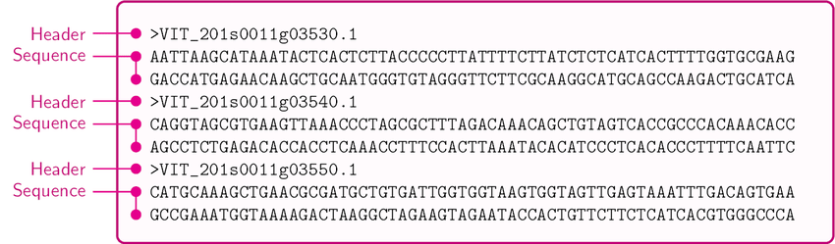
Why FASTA Files ?
FASTA format is a text-based format for representing either nucleotide sequences or amino acid (protein) sequences, in which nucleotides or amino acids are represented using single-letter codes.

Slide 3



Agenda
Introduction.
Section.1:Protein Analysis.
Section.2:DNA Analysis.
Section.3:Using machine learning in Classify FASTA format

Slide 4
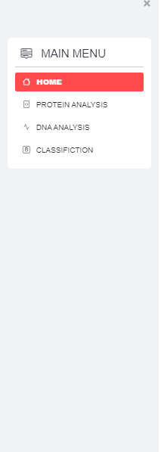

Introduction:
We have created an easy-to-use Website that anyone, whether professional or layman, can use.
Through this website, you can :
Analyze different FASTA files
Display information about the sequence through its unique identifier
Predicting the resulting protein from the occurrence of translation of the genes that make up the sequence
Align more than one file to find out the common origin
predict a gene's function based on the DNA sequence of the coding sequence alone
Using techniques such as machine learning to classify DNA sequences.

Slide 5
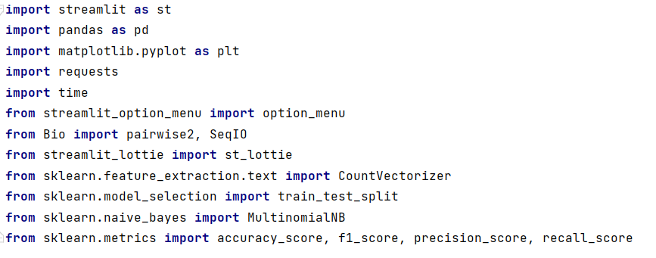
What is The Structure Of Code :
libraries

Slide 6
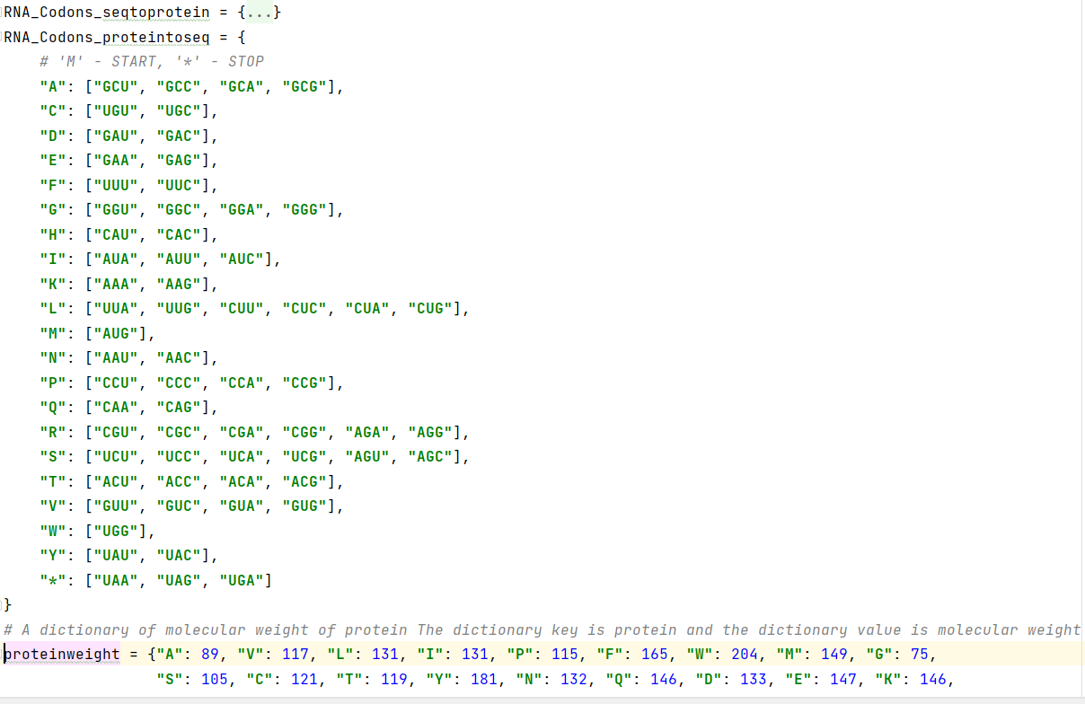
2) Dictionaries: There are three dictionaries
1. RNA_Codons_seqtoprotein:
The dictionary key represents the codon, and the
dictionary value represents the protein
2. RNA_Codons_proteintoseq :
The reverse of the first dictionary represents
the key to the protein dictionary and
represents the value of the codon dictionary
3. Proteinweight :
The dictionary of molecular weight of protein
the dictionary key is protein, and the dictionary
value is molecular weight

Slide 7
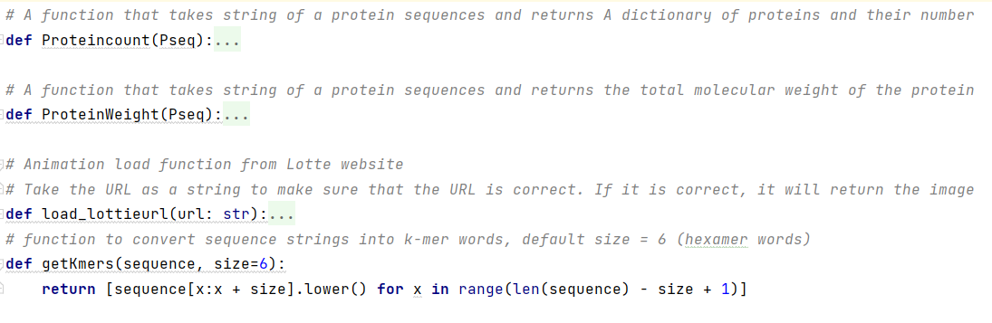
3)Functions : There are three functions
Proteincount:
A function that takes string of a protein sequences
and returns A dictionary of proteins
and their number
2. ProteinWeight :
A function that takes string of a protein sequences
and returns the total molecular weight of the protein
3. load_lottieurl :
Animation load function from Lotte website
Take the URL as a string to make sure that the URL
is correct. If it is correct, it will return the image
getKmers:
Function to convert sequence strings into k-mer words,
default size = 6 (hexamer words)

Slide 8
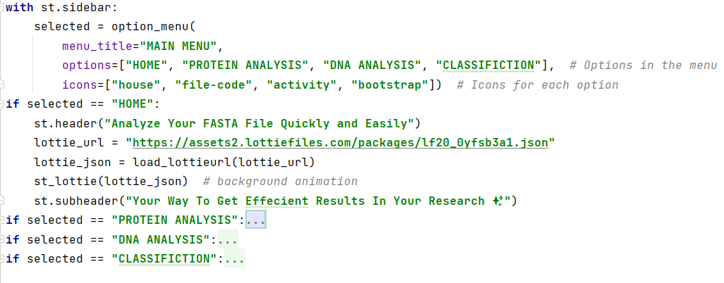
The website is divided into three main categories, each category solving a different problem:
Protein Analysis.
Dna Analysis.
Using machine learning in Classify FASTA format

Slide 9

Protein Analysis

Slide 10
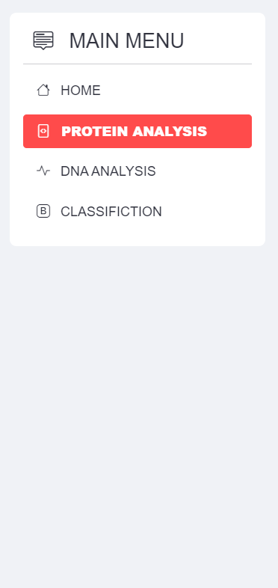

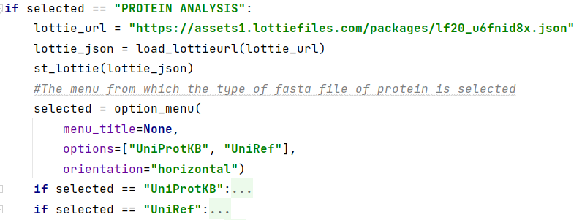
In the Protein section, we analyze three different variants of the Fasta files of a protein.

Slide 11
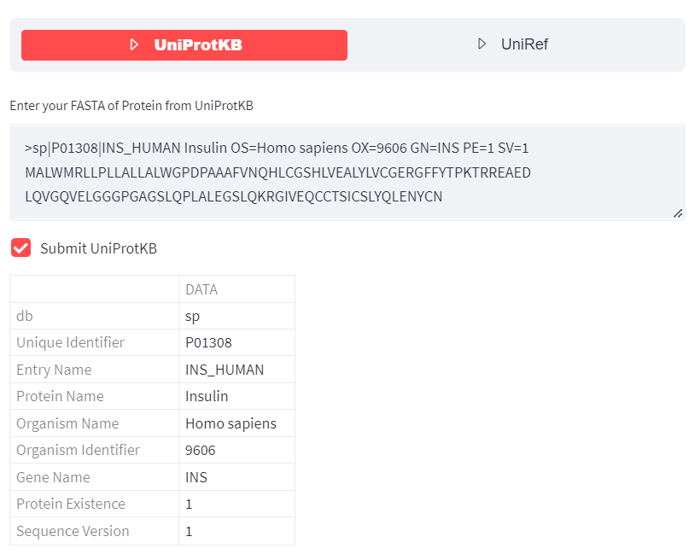
UniProtKB :
Enter the Fasta file for the protein you want to analyze.
Here we have entered the FASTA insulin file, and we have pressed the submit button.
A table will appear showing us the information about the entered file
Ex: The protein database, is it Swiss-Prot or
TrEMBL.
In addition to the name of the protein,
the type of organism in which this protein
is found, and the name of the gene

Slide 12
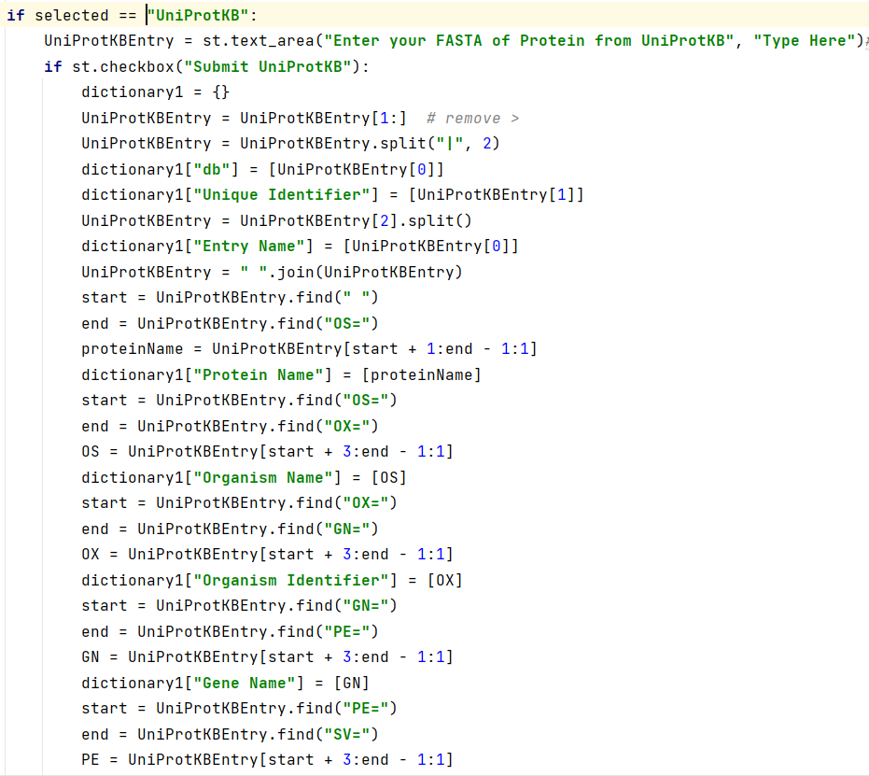
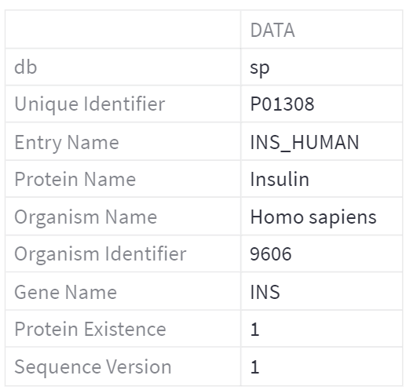
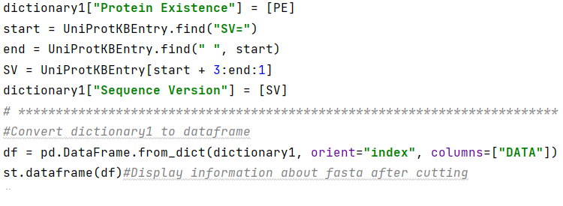

Slide 13
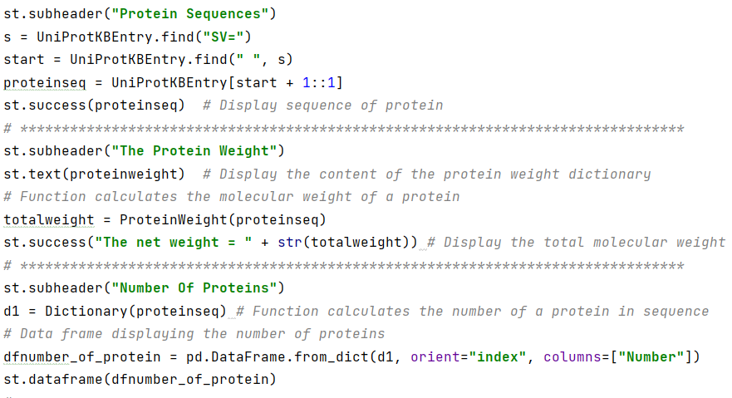
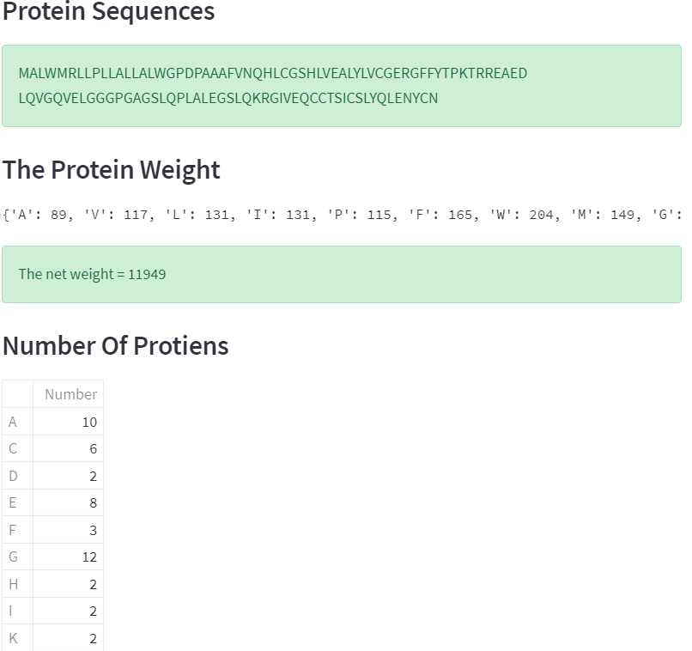
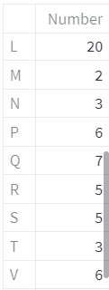
UniProtKB (cont.)
In this part, we have isolated only the protein sequence and shown the molecular weight of each protein and performed some operations to calculate the total partial weight of the protein sequence and display the number of repeats of a single protein in the sequence.

Slide 14
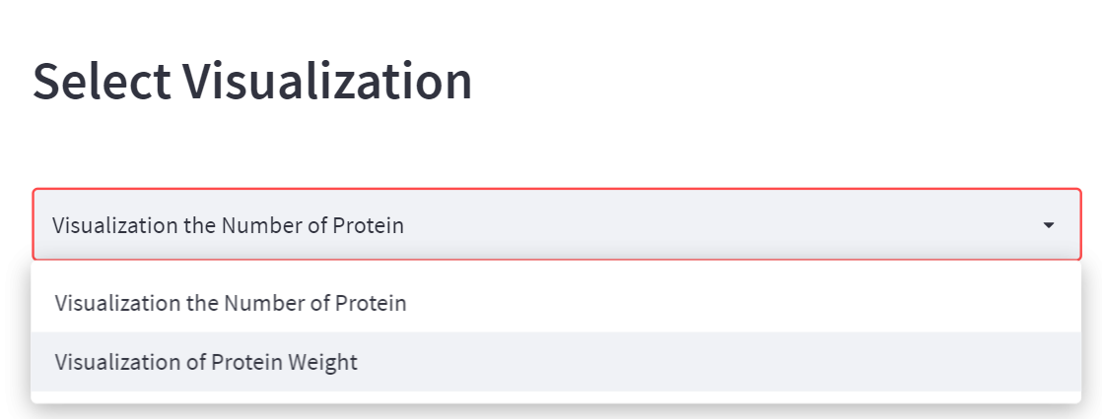
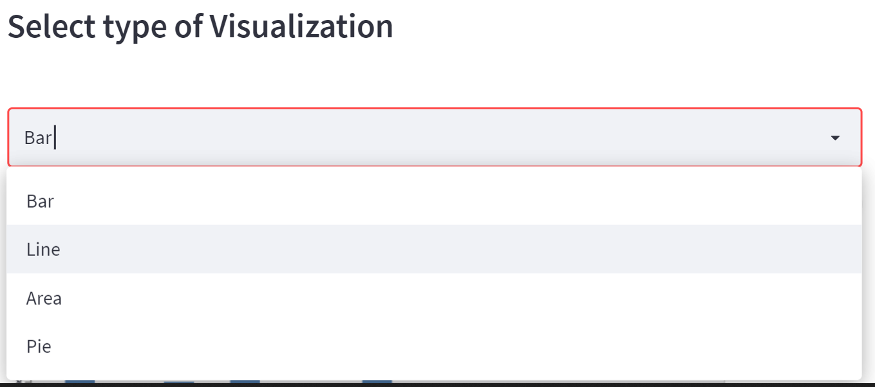
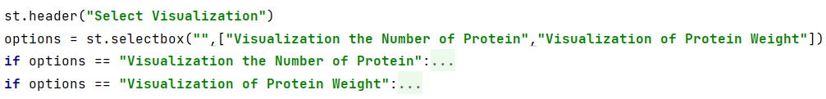
UniProtKB (cont.)
The visualization part is divided into a visualization of the protein molecular weight and a visualization of the number of proteins in the protein sequence, both of which have four different visualizations
[Pie chart-Bar chart-Line chart- Area chart]

Slide 15
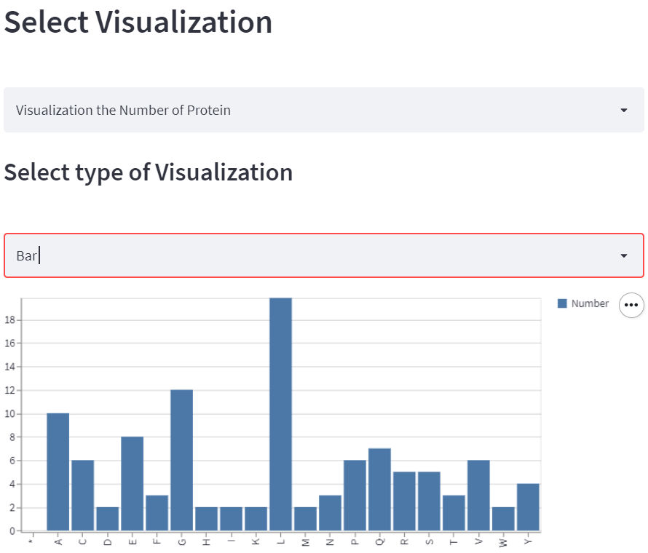
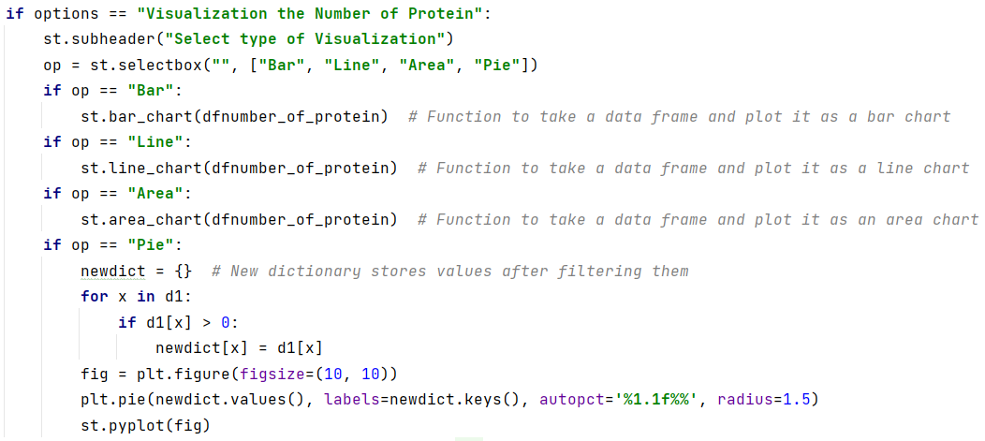
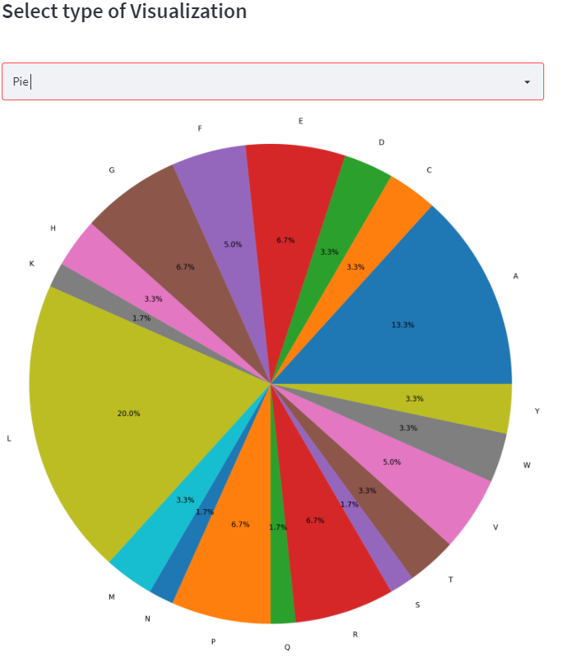
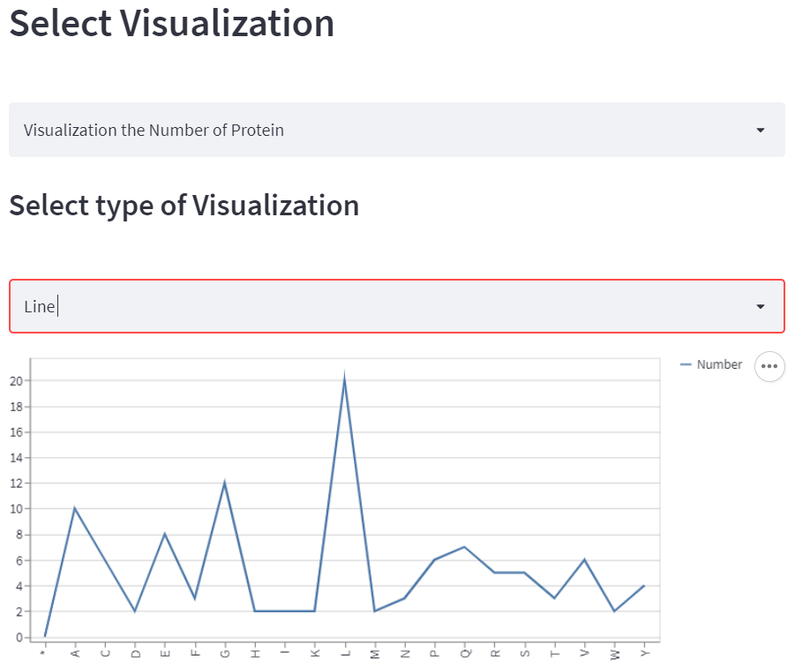
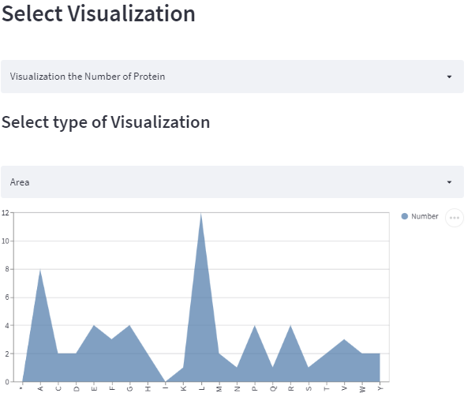

Slide 16
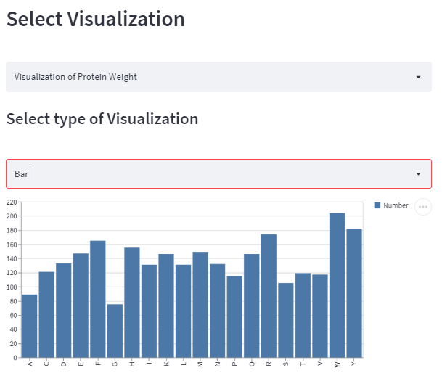
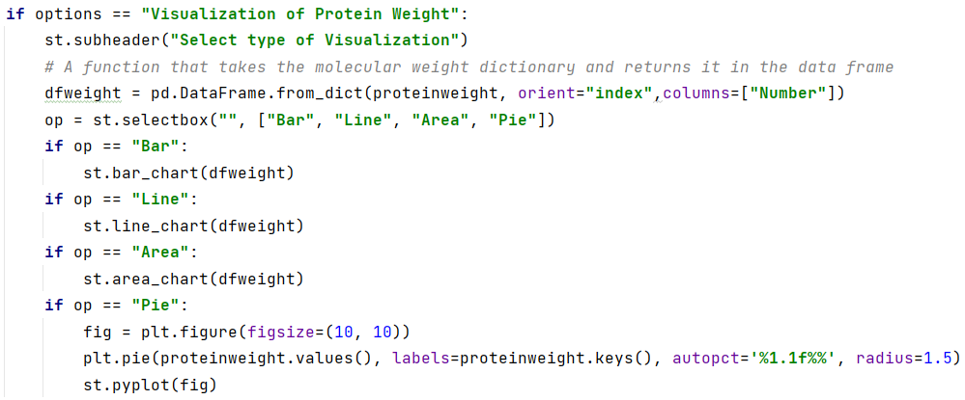
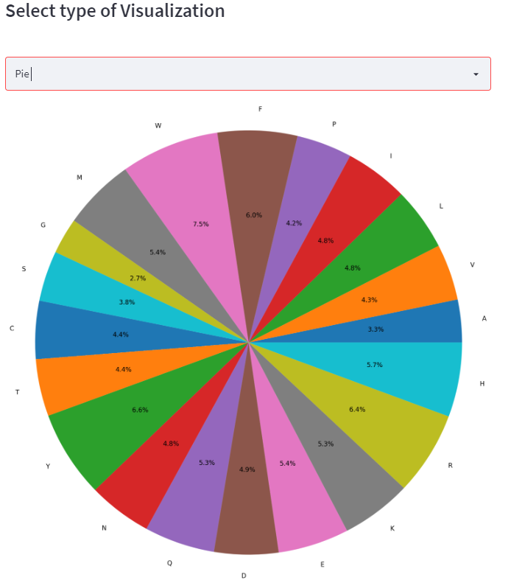
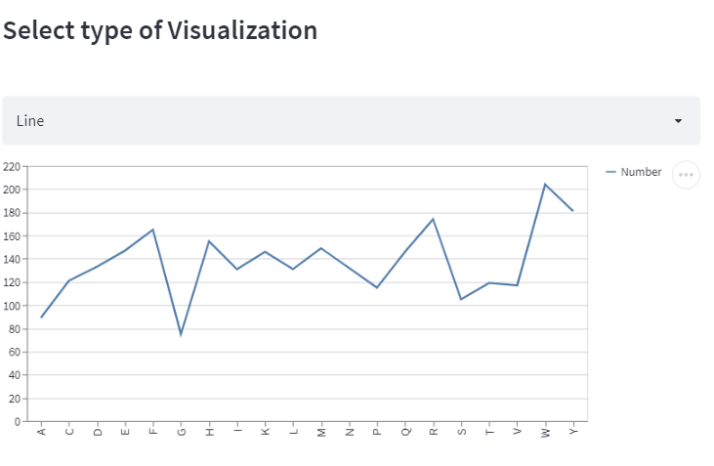
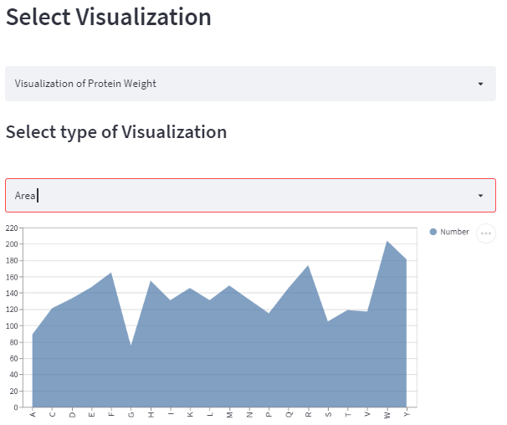

Slide 17
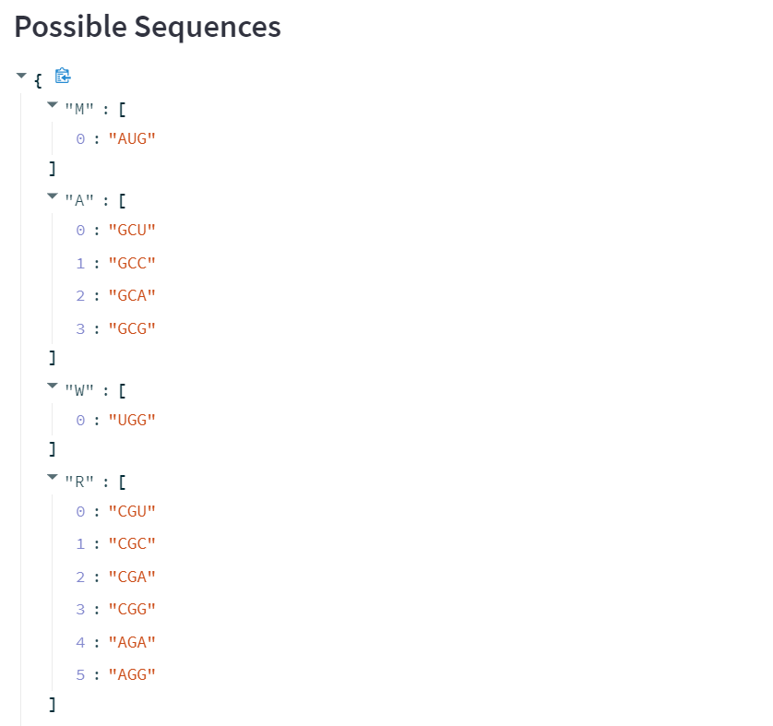
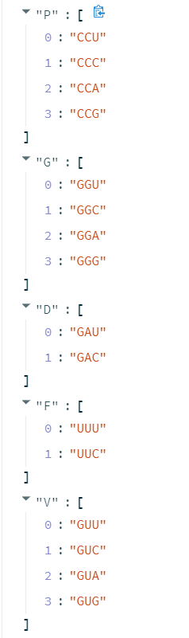
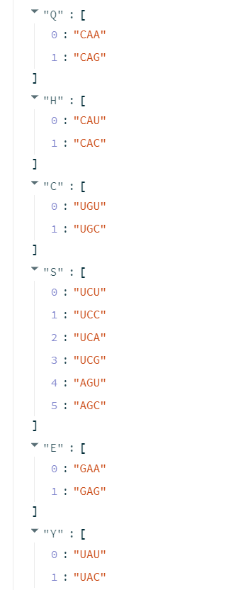
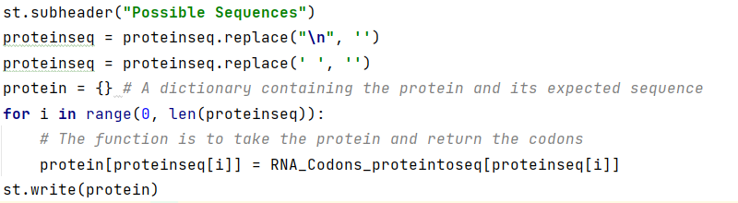
UniProtKB (cont.)
This part shows the possible codons for each protein. Each protein displays its own potential codon, which may be one or more codons.

Slide 18
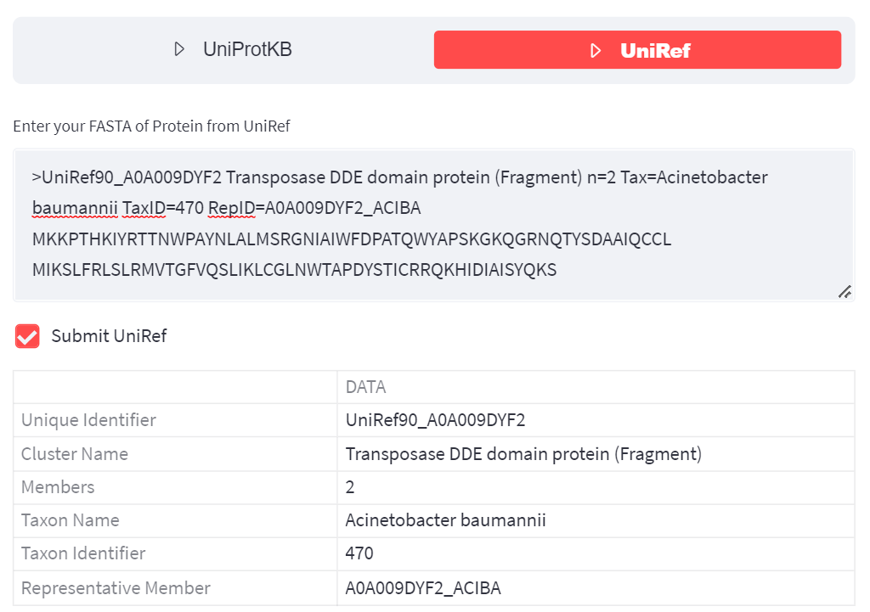
UniRef :
Enter the reference Fasta file for the protein you want to analyze.
The table displays the unique identifier of the reference genome, the cluster name, the number of members, and the representative member.

Slide 19
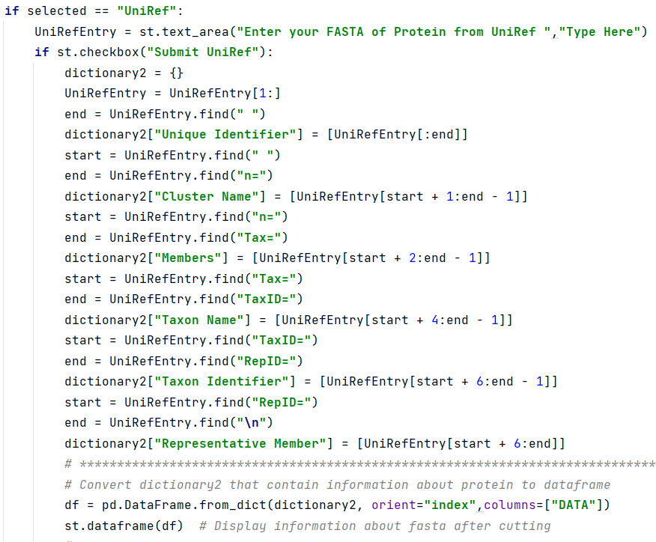
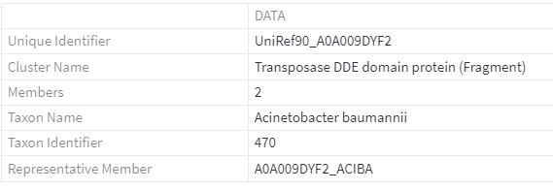
UniRef(Cont.)

Slide 20
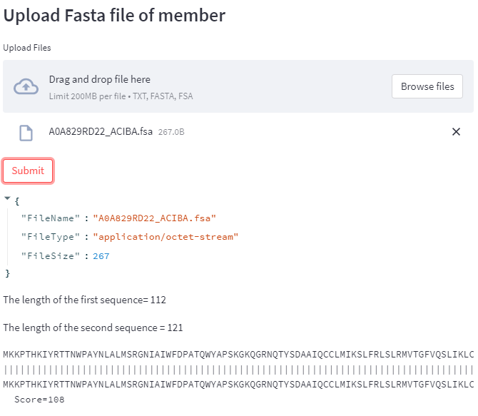
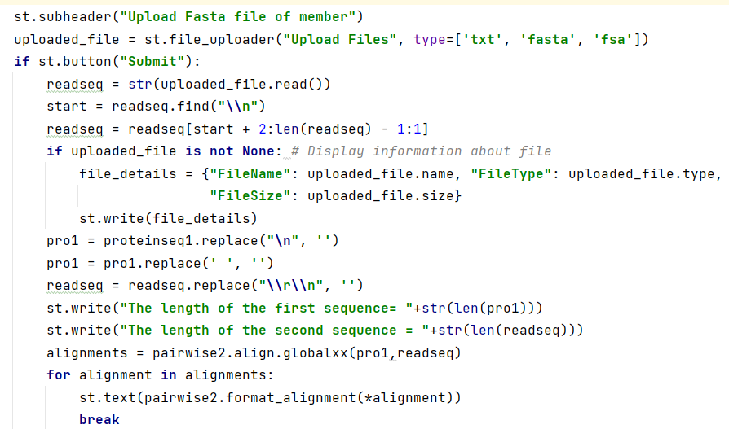
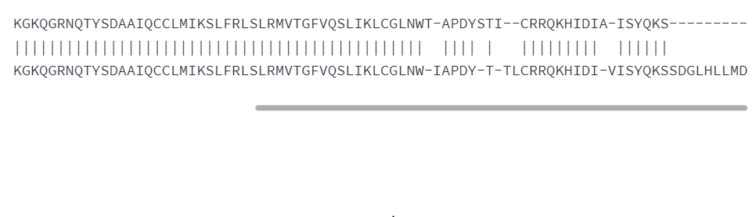

Slide 21

FASTA for DNA

Slide 22
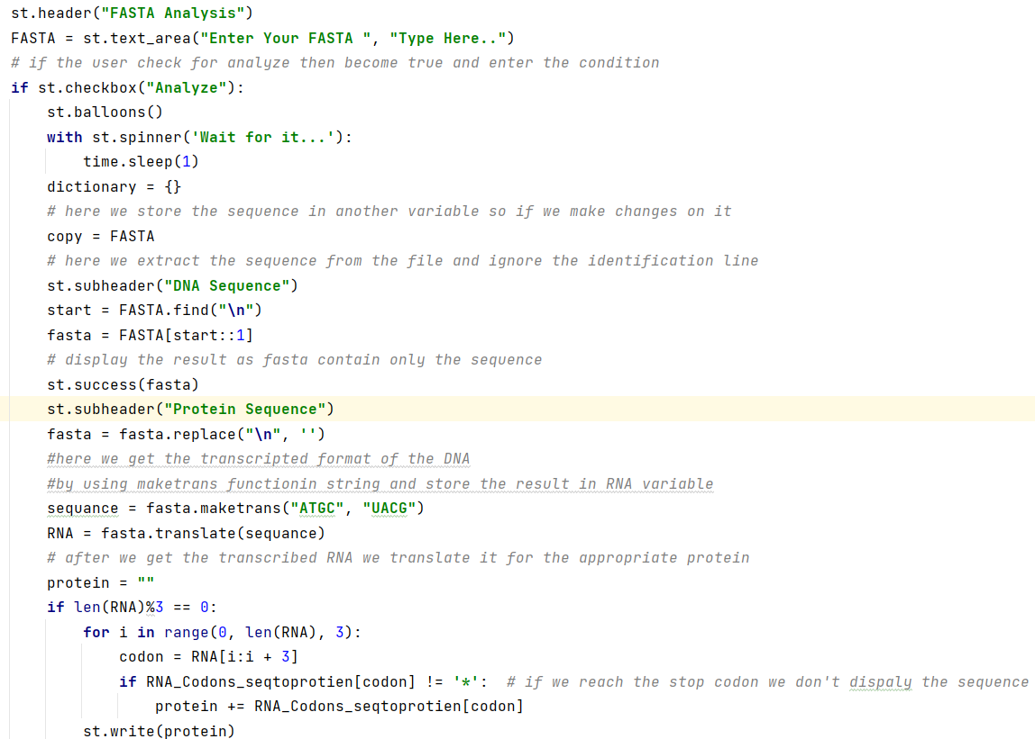
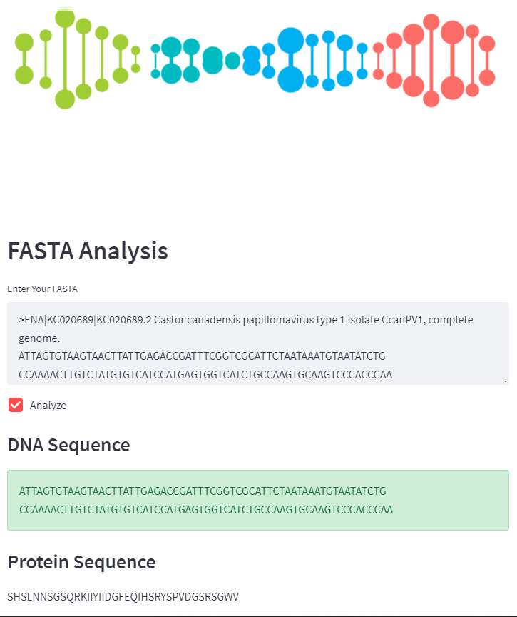
Part Of Insertion Of The Sequence And Prediction OF The Protein

Slide 23
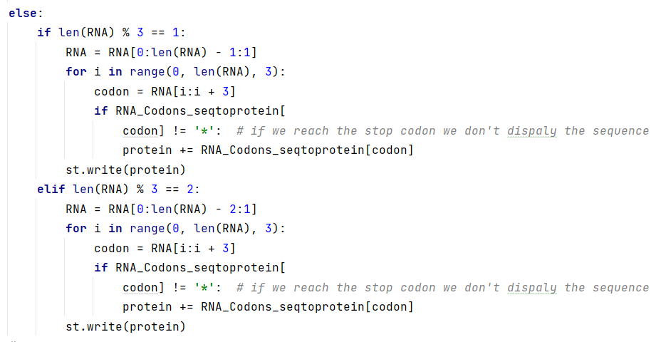
Part Of Insertion Of The Sequence And Prediction OF The Protein

Slide 24
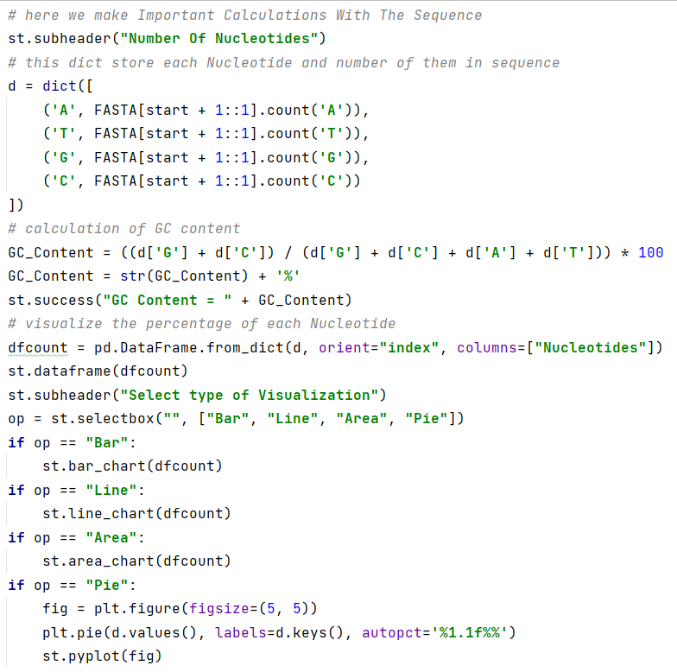
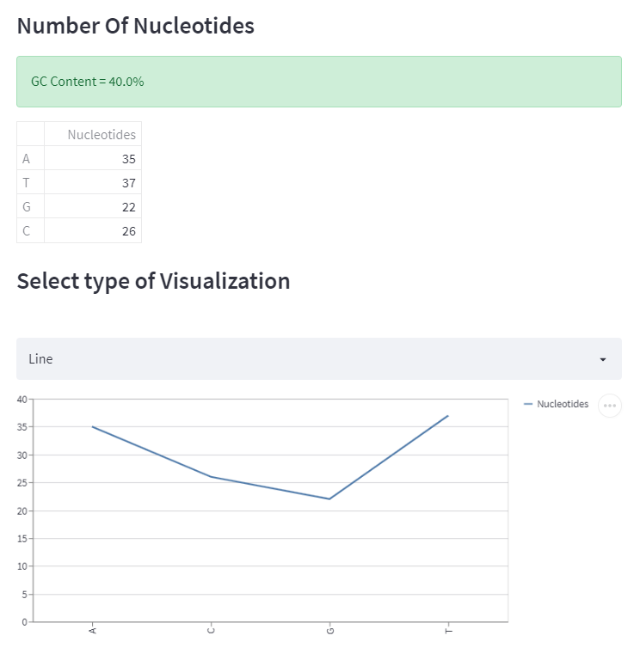
Part Of Making Important Calculations With The Sequence

Slide 25
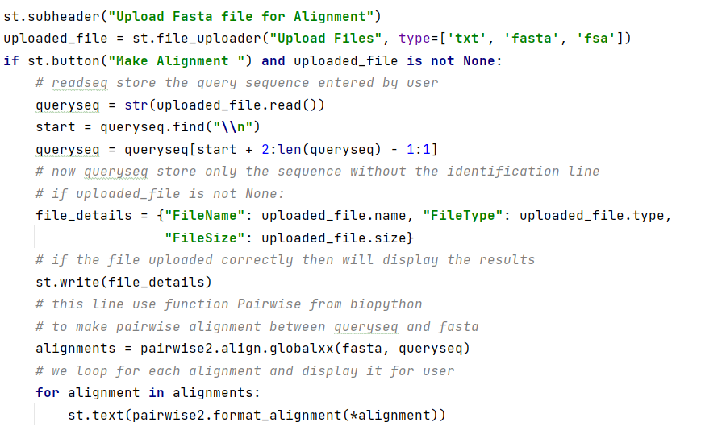
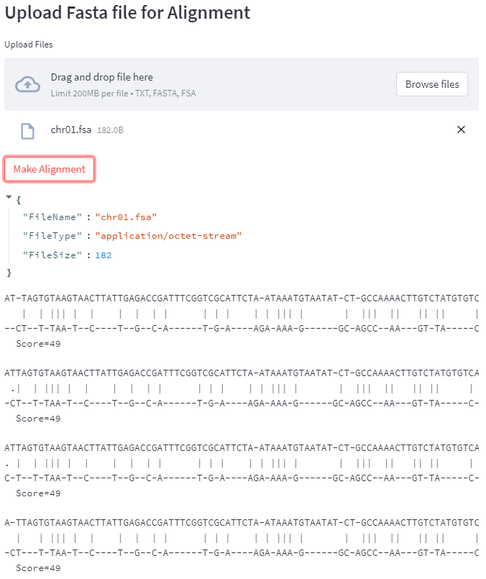
Part Of Making Important Calculations With The Sequence

Slide 26
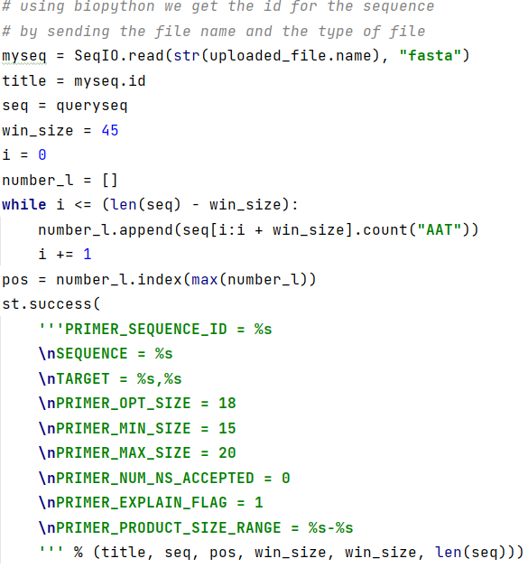
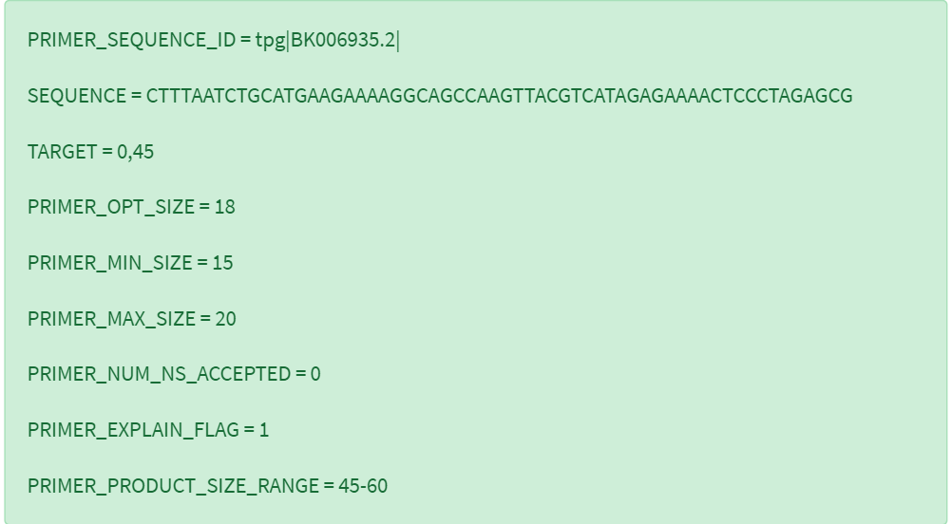

Slide 27
DNA sequencing with Machine Learning

Slide 28

We will apply a classification model that can predict a gene's function based on the DNA sequence
import numpy for array
import Pandas to read file.
import matplotlib.pyplot for creating animated and interactive virsualizations

Slide 29

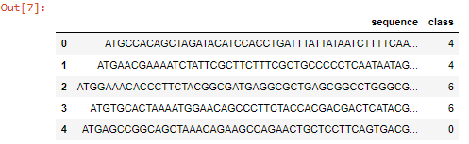
We have some data for human DNA sequence coding regions and a class label.We also have data for Chimpanzee and a more divergent species, the dog.

Slide 30
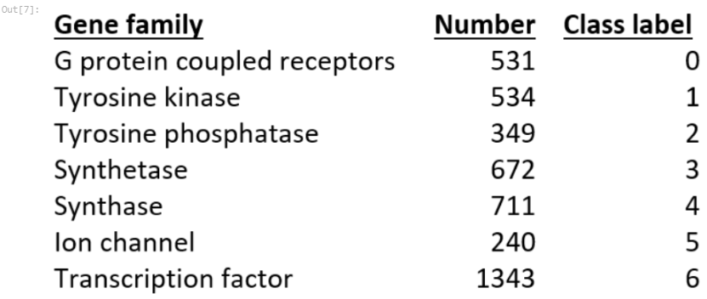
Here are the definitions for each of the 7 classes and how many there are in the human training data. They are gene sequence function groups.

Slide 31
define a function to collect all possible overlapping k-mers of a specified length from any sequence string. We will basically apply the k-mers to the complete sequences

Slide 32
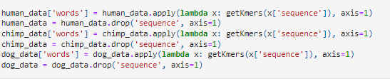
convert data sequences into short overlapping k-mers of legth 6 for each species of data ,using getKmers function.
Hold the sequence and apply a function getKmers to it then drop seq and replaces it with list "words"

Slide 33

coding sequence data is changed to lowercase, split up into all possible k-mer words of length 6

Slide 34

convert the lists of k-mers for each gene into string sentences of words that the count vectorizer can use. make a y variable to hold the class labels.

Slide 35


Slide 36


perform the same steps for chimpanzee and dog
convert the lists of k-mers for each gene into string sentences of words that the count vectorizer can use NLP
combine all seq together, to easy to easy to convert abag of words,convert to list first,then joining all list values with blank space "" in between each other
make a y variable to hold the class labels

Slide 37


Apply the BAG of WORDS using CountVectorizer using NLP
Creating the Bag of Words model using CountVectorizer()
This is equivalent to k-mer counting
The n-gram size of 4 was previously determined by testing

Slide 38


Slide 39


Train_test_split is a function in sklearn model selection for: splitting data arrays into two subsets for training data and for testing data

Slide 40

A multinomial naive Bayes classifier will be created. I previously did some parameter tuning and found the ngram size of 4 (reflected in the Countvectorizer() instance) and a model alpha of 0.1 did the best.
Multinomial naïve bayes classifier ,the alpha parameter eas determined by grid search

Slide 41




Slide 42

show output in web page

Slide 43


Slide 44


Slide 45


